Slide 1
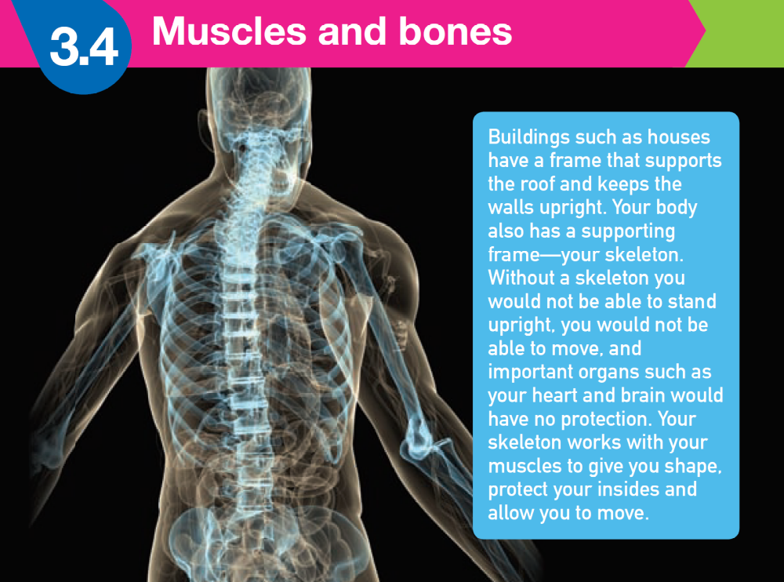
MUSCLES & BONES
p. 109-114

Slide 2
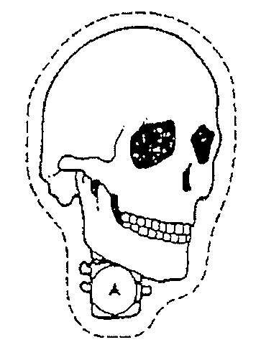
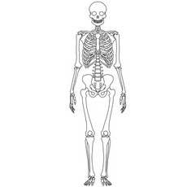
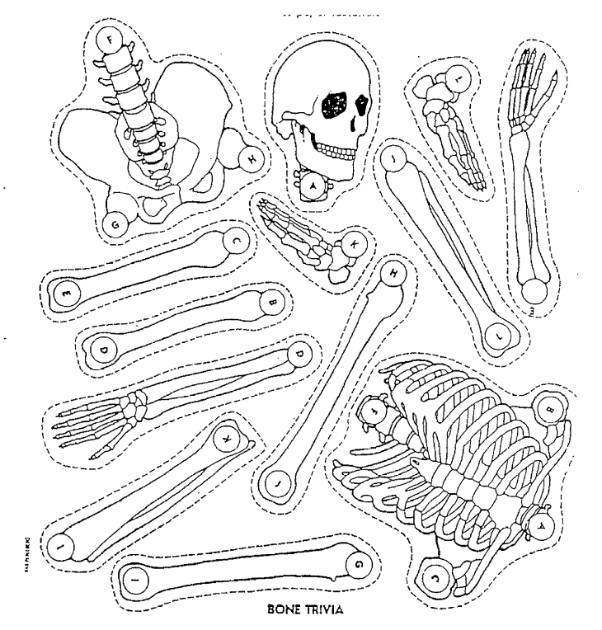
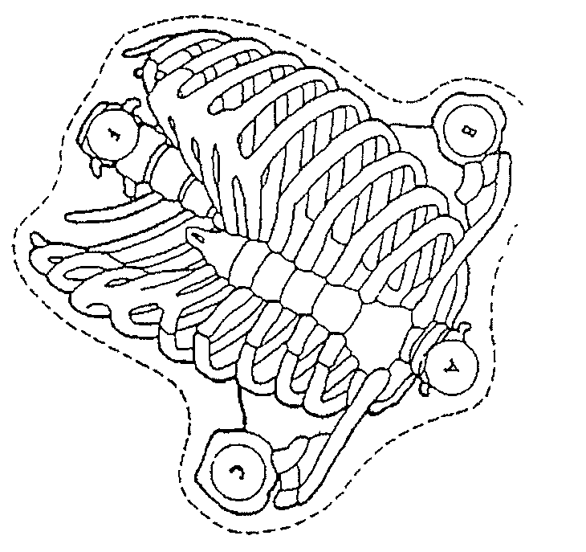
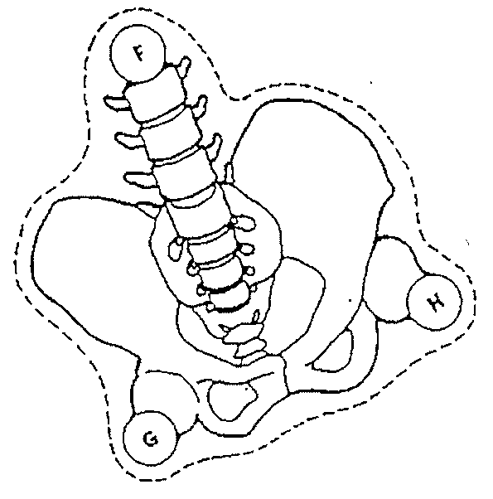
SKELETON
The skeleton is the body’s frame.
Three functions:
- Supports your soft tissues

Slide 3
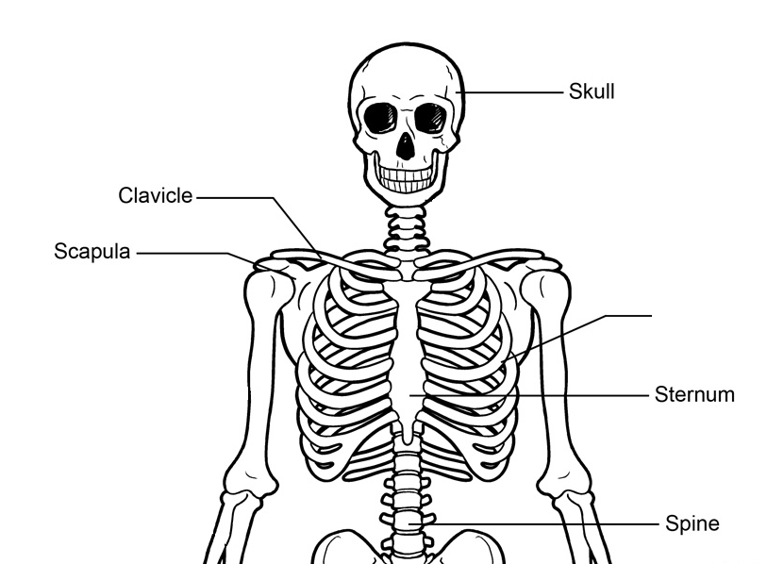
-Axial skeleton
80 bones
Protects your vital organs
• Skull-protects brain
Vertebral column
- protects spinal cord
• Ribs & breastbone
- protects lungs & heart.
Scapula
Ribs
/ Vertebrae

Slide 4
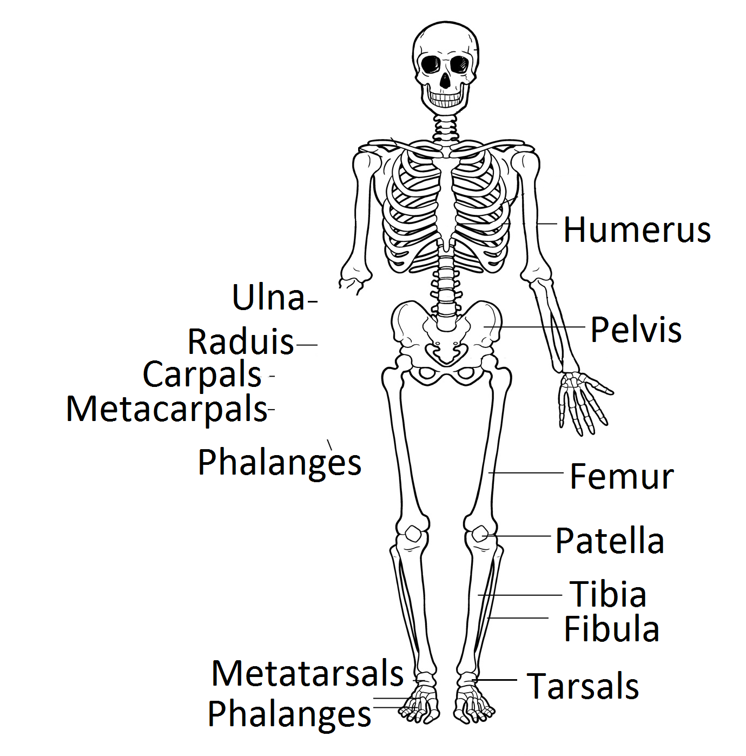
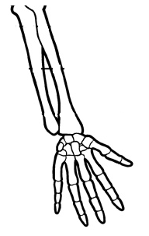
-Appendicular skeleton
126 bones
-joints within
the skeleton
allow you
to move.
•Shoulder blades
•Arms
•Legs
Clavicle
Scapula
*little finger
*thumb

Slide 5
Characteristics of bone
STRONG – do not snap or crumble during normal activity
LIGHT – so that your muscles can move bones.
SLIGHTLY ELASTIC – so it can flex and twist a little & return to its original shape when it is forced.

Slide 6
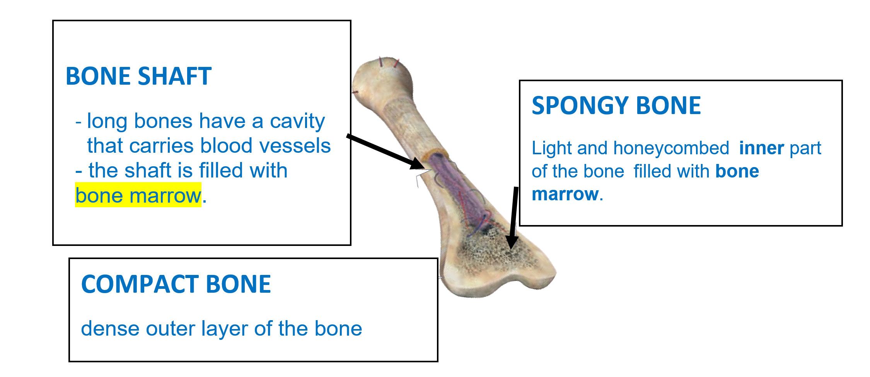
D
E
F
G Bone marrow: Jelly-like material that makes red blood cells, platelets and some white blood cells are made here.

Slide 7
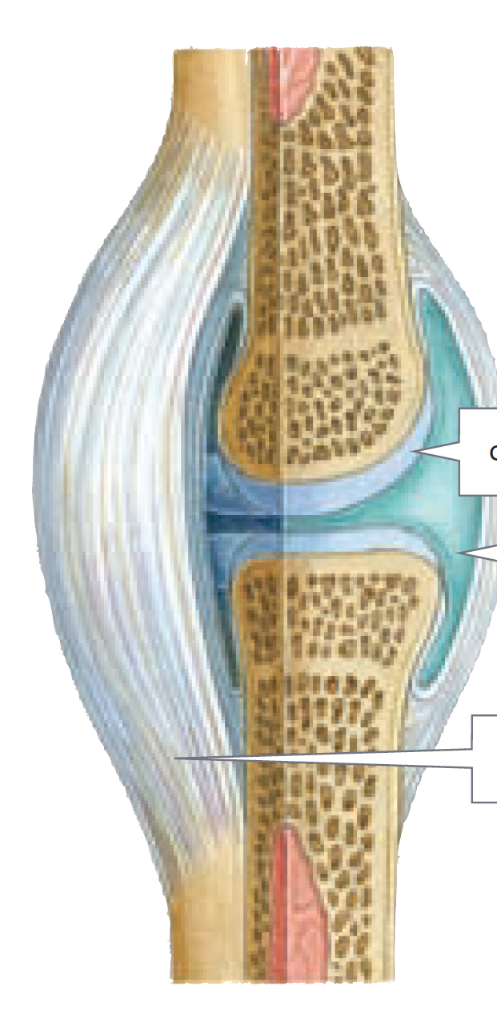
A
CARTILAGE: smooth and slippery material at the ends of bones that are moving against each other.
It helps to cushion the impact of movement
SYNOVIAL FLUID: fluid that which lubricates the bone ends and allows them to slide over each other freely.
LIGAMENT:
bands of tough, flexible tissue that hold the bones in a joint together.
B
C

Slide 8
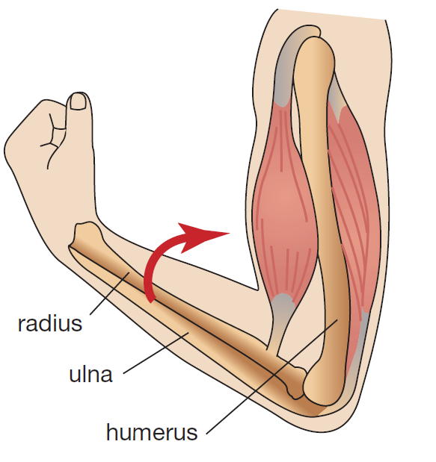
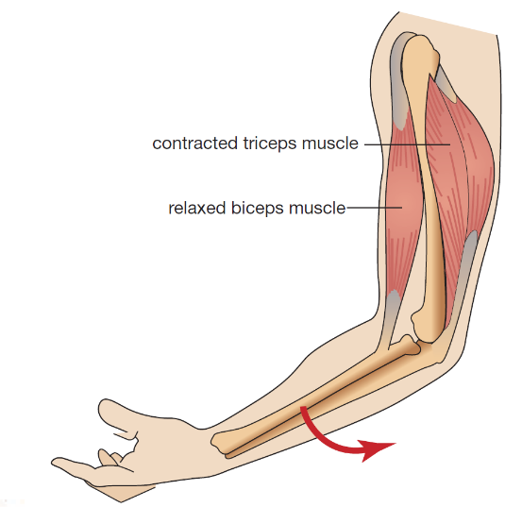
JOINTS: a place in the body where two bones come together.
TENDONS:tissues that attach muscles to bones and hold the muscles in position.
MUSCLE: tissues that contract and stretch to move bones.
Antagonistic pair
Tricep relaxes
Can: pull Cannot: push

Slide 9
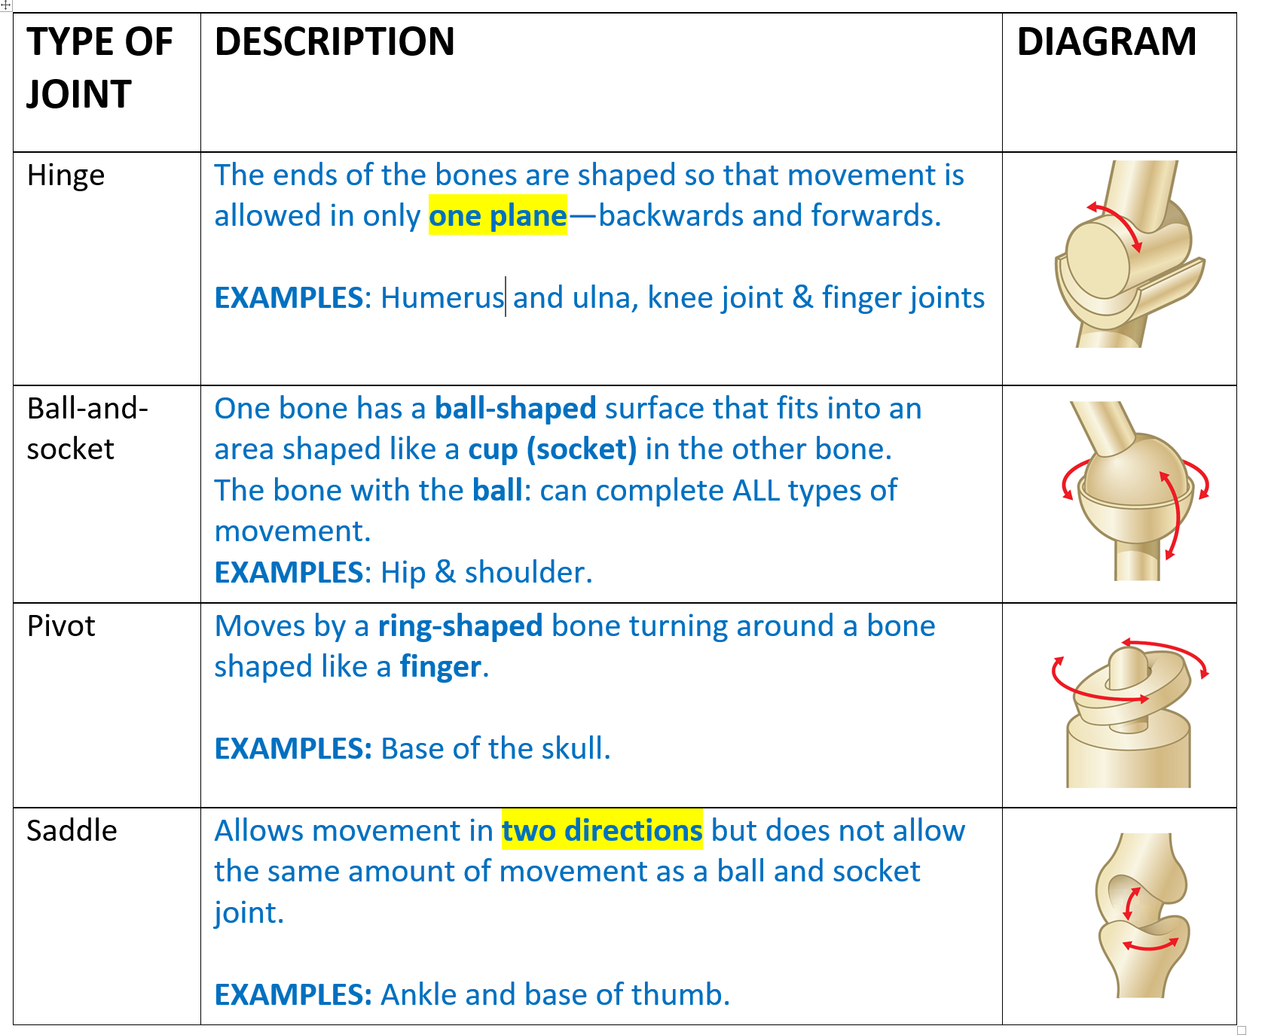

Slide 10
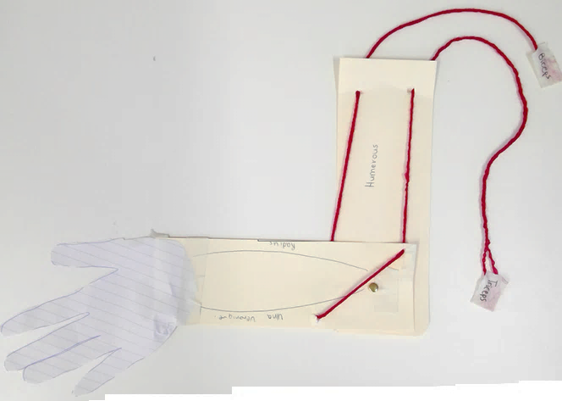
Make holes with pen or
hole punch
Holes for string
BICEPS
Holes for string
Where the split pin goes
HUMERUS
RADIUS
HINGE JOINT
TRICEPS
ULNA
*String is behind
MAKE YOUR OWN ARM MODEL

Slide 11
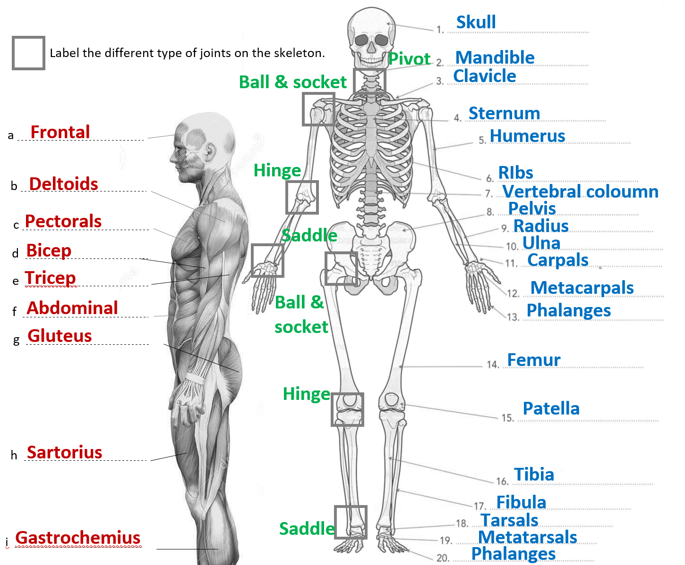

Slide 12
